Slide 1

Understanding of the Video Game Industry
Presenter : Loh Joo Meng
Notes:
Good Afternoon, my name is joo meng you can call me jay for short. I will be leading this presentation on global video game sales analysis looking into the past, present and future of the gaming industry

Slide 2
Consumerism & Capitalism
Consumerism is the central point of the globalization. Global capitalist system is to promote consumerism (spending) among people with no regard for their own ability to pay for what they are consuming. At this point return to our central question „Consumerism is the core ideology of the Capitalism‟.
In common use, consumerism refers to the tendency of people living in a capitalist economy to engage in a lifestyle of excessive materialism that revolves around reflexive, wasteful, or conspicuous overconsumption.
Notes:
Globalization and its global capitalist system this has brought about consumerism, which is the focal point of globalization. it promotes consumerism (spending) amongst people who has no regard for their own ability to pay or afford what they consume. This creates a lifestyle of excessive materialism that revolves around reflexive, wasteful, or conspicuous overconsumption

Slide 3

Background
Who are we?
Sequoia Capital a venture capital firm is interested in branching out into the video game development scene, and has tasked us to provide valuable insights, video game sales data has been gathered from various game developers and publishers in the industry across multiple regions around the world.
At J & E Analytics., we’re passionate about transforming raw data into actionable insights. Our team of seasoned data analysts, engineers, and strategists collaborates to unlock the hidden potential within your data. Whether you’re a startup or an enterprise, we’re here to empower your decision-making process.
Notes:
Lets begin with a short background of your company sequoia capital, a venture capital firm is interested in investing in the video game development scene. and has gathered data from various game developers in the industry across multiple regions around the globe. we at j & e analytics are here to provide insights and propose potential minimum viable products for your consideration. slide 3

Slide 4

Problem Statement
The Era of Digitalization
The present age where digital technologies like computers, the internet, mobile phones, and cloud computing are widely used and adopted, changing the many facets of human life, society, business, and culture.
We recognize from the data provided that the glaring problem of physical Video Game Sales has been on the decline. There are many video game developers in the gaming industry in 2024, from small indie firms and individuals to large prominent game development companies with long standing backgrounds. We will be providing analysis on the changes in sales within respective regions, genres, and consoles
Notes:
The problem at hand, in this age of digitalization, where digital technologies are widely used and adopted we recognise that from the data provided, there is a glaring problem, which is the decline of physical video game sales. we will be providing analysis on the changes of sales within regions, genres and different consoles.

Slide 5

Objectives
Delve into Regional Sales Dynamics
Evaluate Metacritics Influence and Impact on Sales
Provide Analysis on Industry growth
Analyze Console/Genre popularity
Notes:
our objectives today are delving into regional sales dynamics, evaluating metacritics influence and impact on sales, providing analysis on industry growth and analyzing console genre popularity.

Slide 6
Excel
Removing and adding field + description for Data dictionary.
Power BI
Removing unwanted Columns
Replacing Null Values
Checking data types
Renaming Columns
Total , NA, JP, PAL, Other Sales
Notes:
so before we get into data analysis we have to perform data cleaning, in excel and powerbi slide 6 (edited)

Slide 7
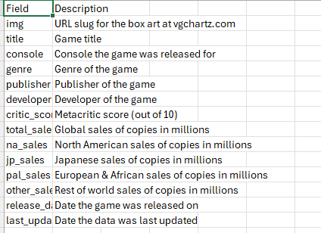
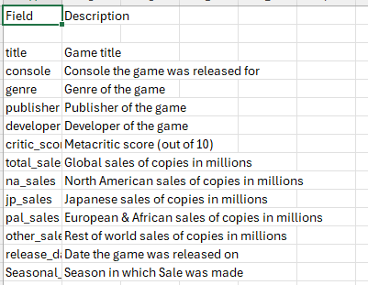
Excel Data Cleaning
Notes:
Firstly in excel, these are the changes we have made highlighted in red for the data dictionary the next slide would show the final result in powerbi(next slide) (slide 7/8)

Slide 8
Data Dictionary (Sources)
Field | Description
Title | Game Title
Console | Console the game was released on
Genre | Genre of the game
Publisher | Publisher of the game
Developer | Developer of the game
Critic Score | Metacritic Score (out of 10)
Total Sales | Global Sales of copies in millions
NA Sales | North American Sales of copies in millions
JP Sales | Japanese Sales of copies in millions
PAL Sales | European & African Sales of copies in millions
Other Sales | Rest of world Sales of copies in millions
Release Date | Date the game was released on
Seasonal Sales | Season in which Sale was made

Slide 9
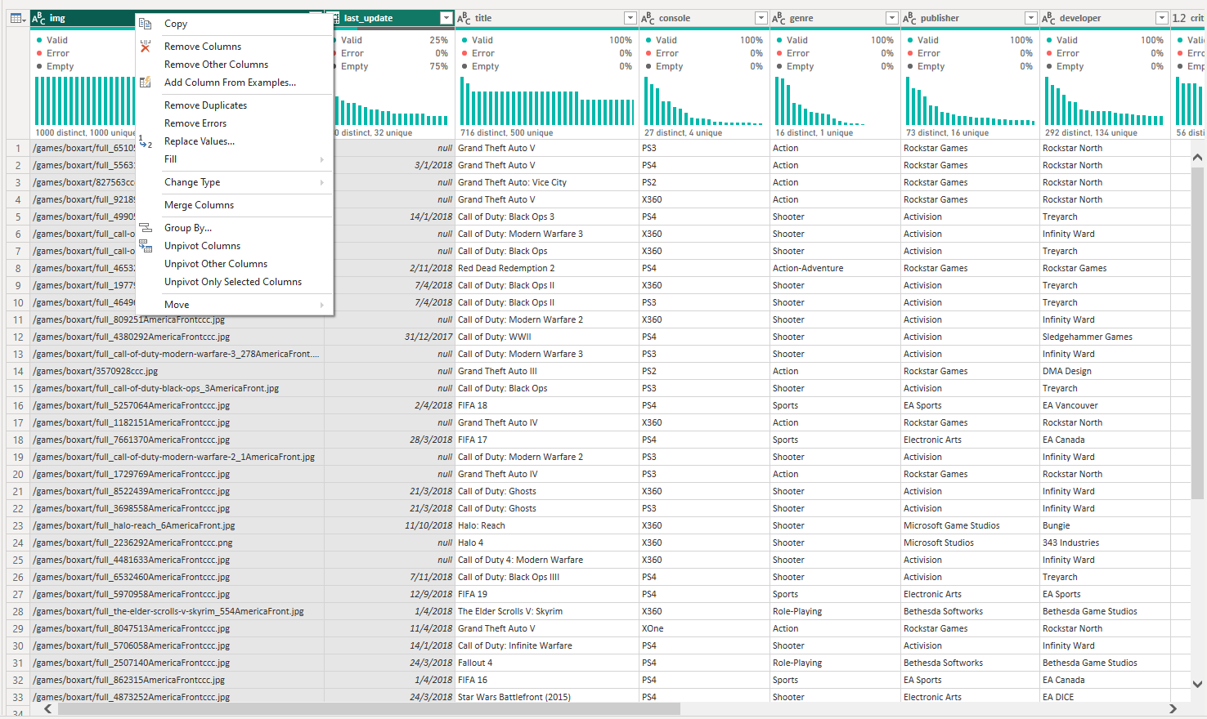
Power BI Data Cleaning
Removing Unwanted Columns
From this Image, we can see that both the img and last_update files are irrelevant to the data analysis we would be performing, therefore the need to remove them.
Notes:
Now data cleaning for the data file in powerbi. we select both the img and last_update columns and removed them as they are unnecessary for analysis(shown in red on the screen)

Slide 10
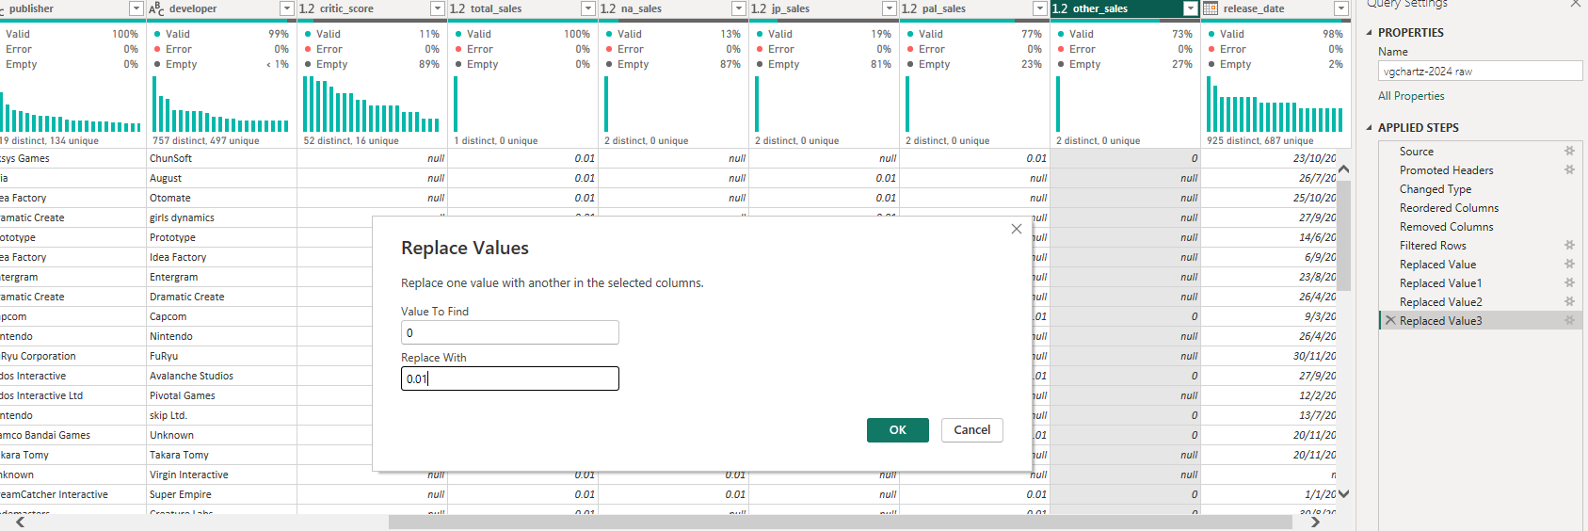
Replacing Values
We have replaced the 0 Values in total,na,jp,pal and other sales to the lowest possible value in 2nd decimal place which is 0.01.
The primary reason why the value is shown as 0 instead of null is because there are sales in the region but since the values are in Millions, we are not able to reflect down to the 7th decimal place. Hence for visual purposes we rounded them up to the 2nd decimal place
Notes:
n the sales columns we recognise that there are null values and 0 values Now to understand the difference between these values As we can see from the data dictionary these sales values are in the millions, due to the constraints where we can only see up to 2 decimal places, 0 values actually represent values that are beyond the 2nd decimal place, therefore we will round them up to 0.01 which is the lowest value that is available for visualization. (edited)

Slide 11
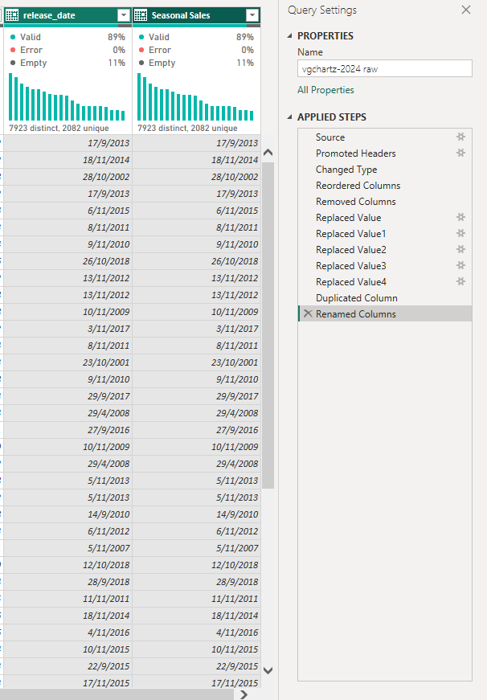
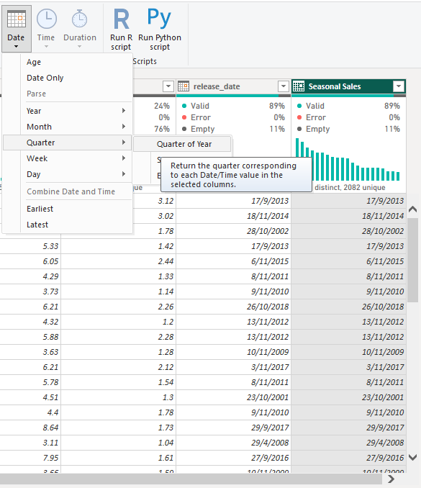
New Column for Seasonal Sales
In order to display sales by the seasons to understand seasonal sales patterns, we have done the following steps:
Duplicated the release date column
Renamed the Column to Seasonal Sales
Changed the Date format to Quarter
Lastly reassigning values to the respective quarters (next slide)
Notes:
to understand the cyclical movement of video game sales, we duplicated the release date column and changed its date formatting to show its release by quarter, this would show us a visual breakdown on when a game was published and its sales on release

Slide 12
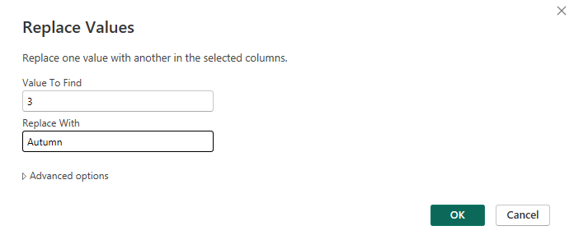
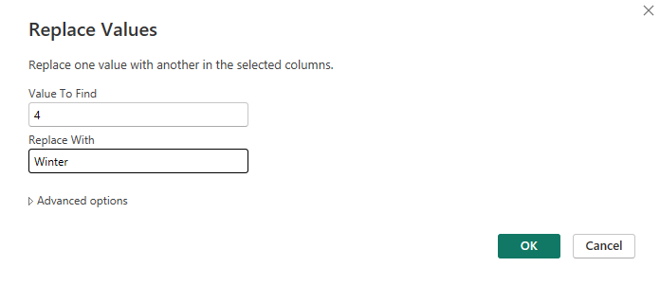
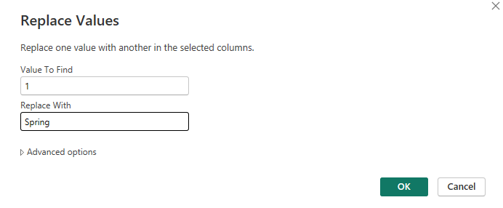
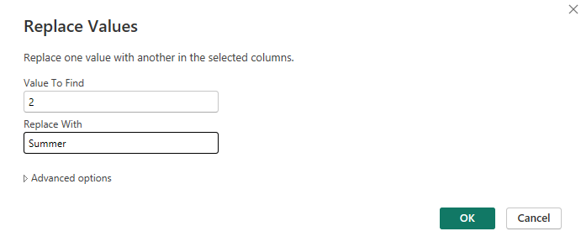
Replaced Values
Notes:
in this slide, we simply changed the numerical values to reflect its season

Slide 13
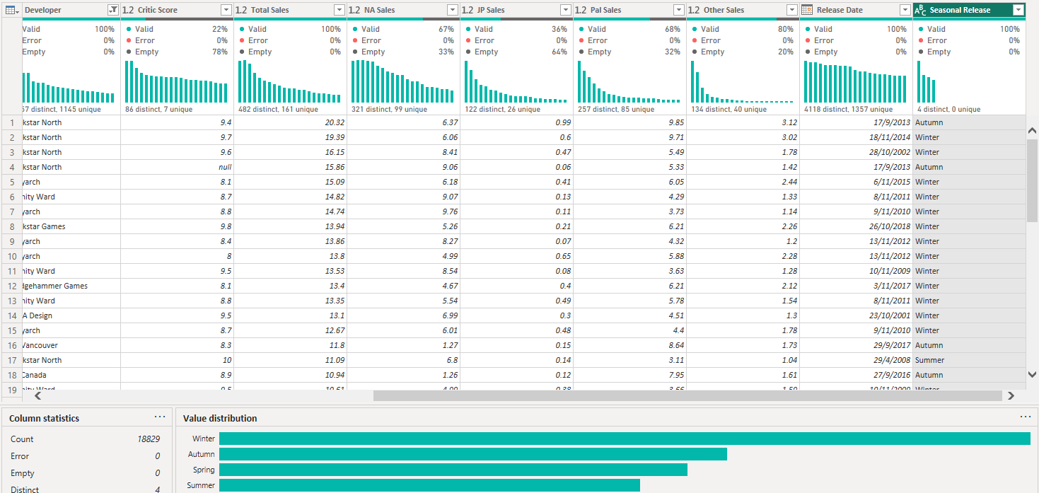
Seasonal Sales

Slide 14

Scope of Data
In-Scope
Out-Scope
Video games purchased in retail stores such as Game Stop, Walmart, and Target and online such as on Amazon
Games purchased via the internet such as Steam, Origin, Blizzard’s Battle.net, Xbox Games Store, PlayStation Store, and Nintendo Shop for consoles
Notes:
We will be looking to derive insights which can benefit game developers and publishers by pinpointing successful strategies and new opportunities in the global gaming market.
Before performing data analysis we need to understand whats in and out of scope of the data analysed.
IN-the scope are Video games purchased in retail stores such as Game Stop, Walmart, and Target and online such as on Amazon
whats OUT-OF-SCOPE which is not included in the dataset are Games purchased via the internet such as Steam, Origin, Blizzard’s Battle.net, Xbox Games Store, PlayStation Store, and Nintendo Shop for consoles

Slide 15
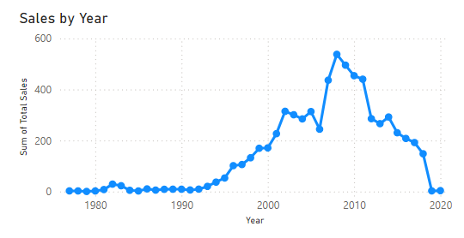
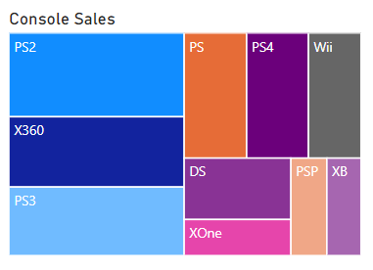
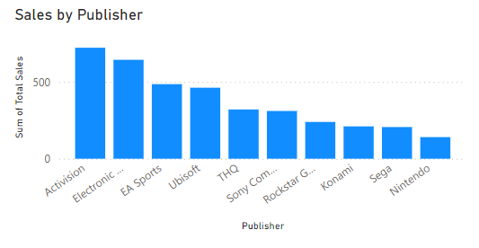
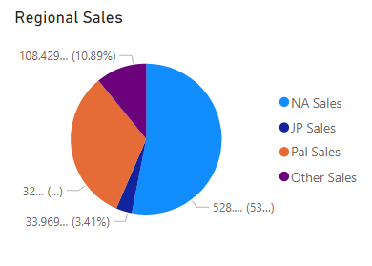
Meta Data Analysis
Notes:
From here on out, we will be looking more at the meta data and the insights we can derive from them, this is the overview snapshot of what the data presents. Sales by year, by publisher, by region, and by console.

Slide 16
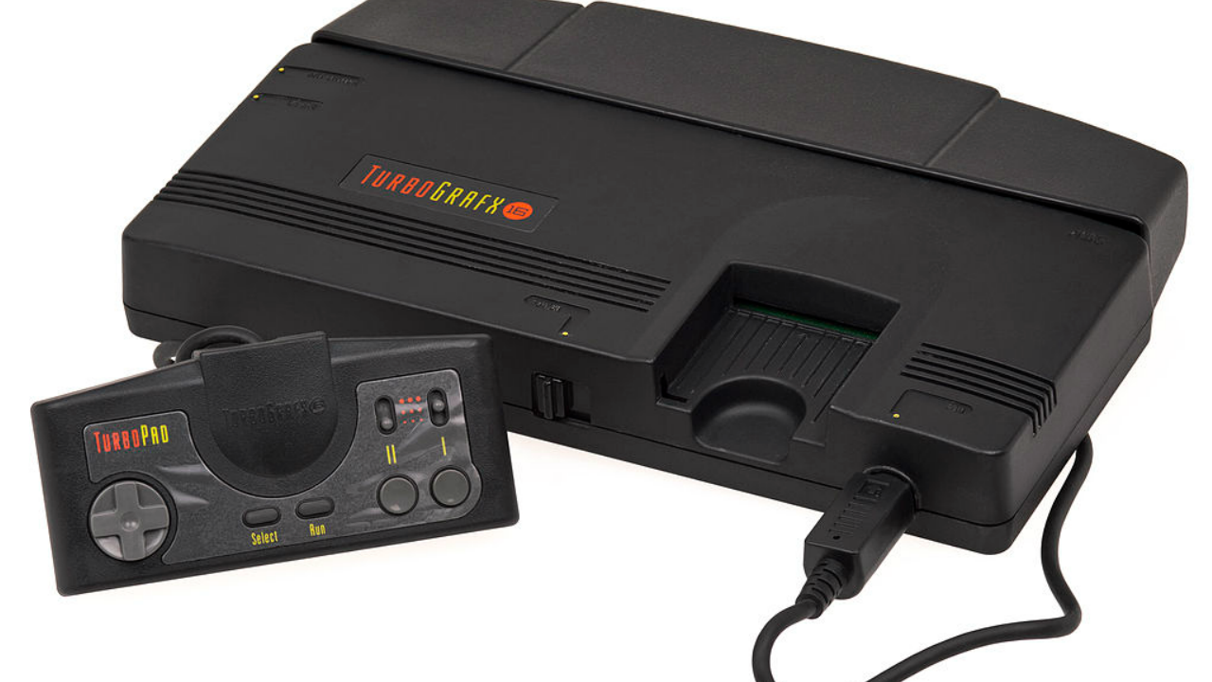
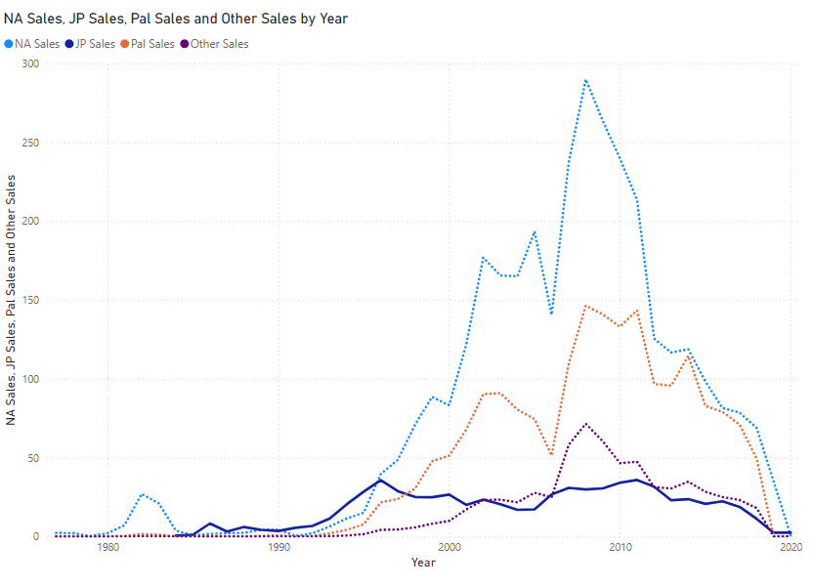

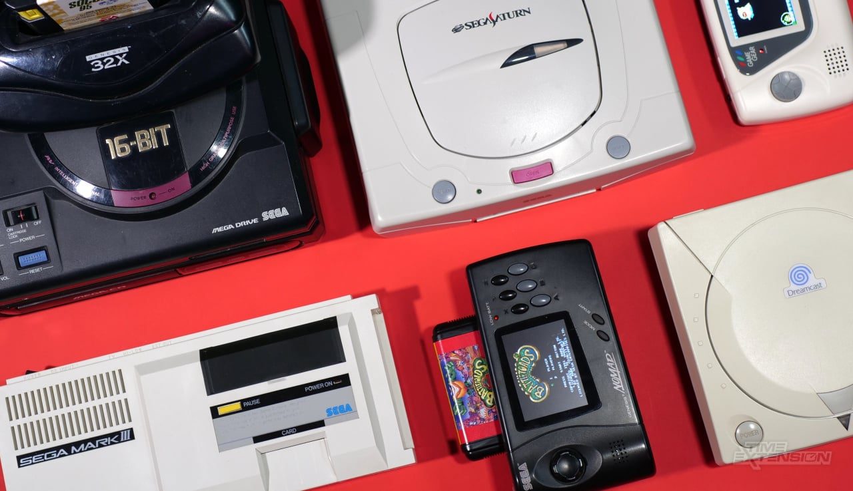
Anomaly The Japanese Market
Notes:
Firstly when we compared the sales by region we noticed an anomaly.
Although the Japanese region does not have as big of an impact as American or European sales, there is an anomaly where sales is more consistent compared to the other regions
Why is that so?
John who runs aTokyo game localization physical game publisher for the Japanese market. Says “People still are used to going to stores here in Japan and buying physical items,”
“When compared with other markets, it seems Japan still absolutely loves physical games,” the most recent survey from Japan’s Computer Entertainment Supplier’s Association (CESA). CESA found that physical games accounted for about 70 percent of total sales in Japan in 2022 By comparison, Sony says that 70 percent of full PS4 and PS5 game sales in 2022 were digital across the world.

Slide 17
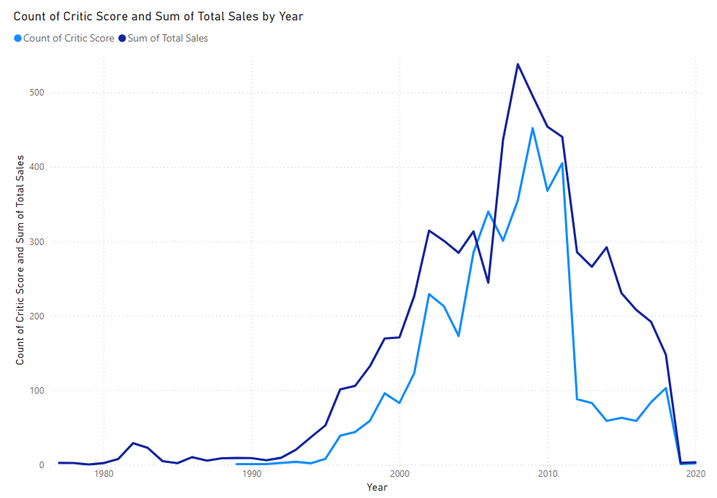
Correlation of Critic Score To Sales
Notes:
In this slide, we can infer that game sales has a positive correlation to critic scores, as most consumers are interested in hearing about positive experiences with the reviewed product or service
https://www.statista.com/outlook/amo/media/games/physically-sold-video-games/worldwide#:~:text=Given%20the%20worldwide%20surge%20in,are%20experiencing%20a%20gradual%20decline.

Slide 18
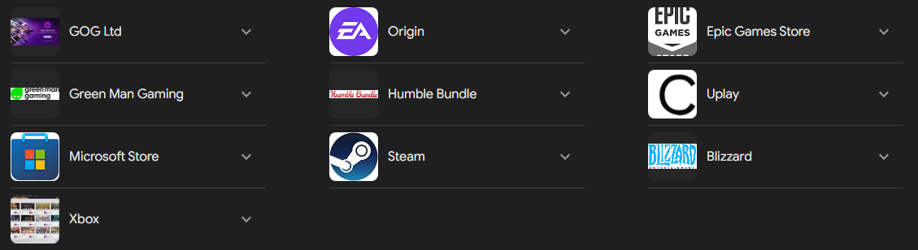
PC Desktop Applications

Slide 19
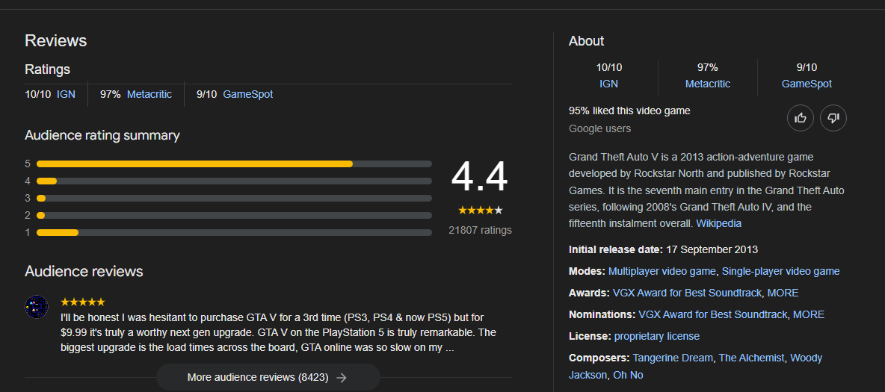
Metacritics review score
Notes:
This is the data from which our critics score have been derived from

Slide 20
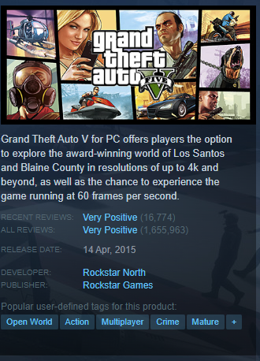
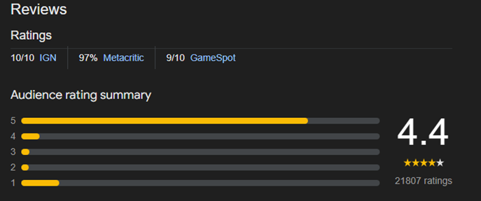
Comparison to In App review count
Notes:
As we can see, the data in which our reviews is centered around is on the left, however our out of scope data which are the reviews on other apps such as Steamare not reflected. The following slides which we will glide through are snippets of these apps where games can be purchased online.

Slide 21
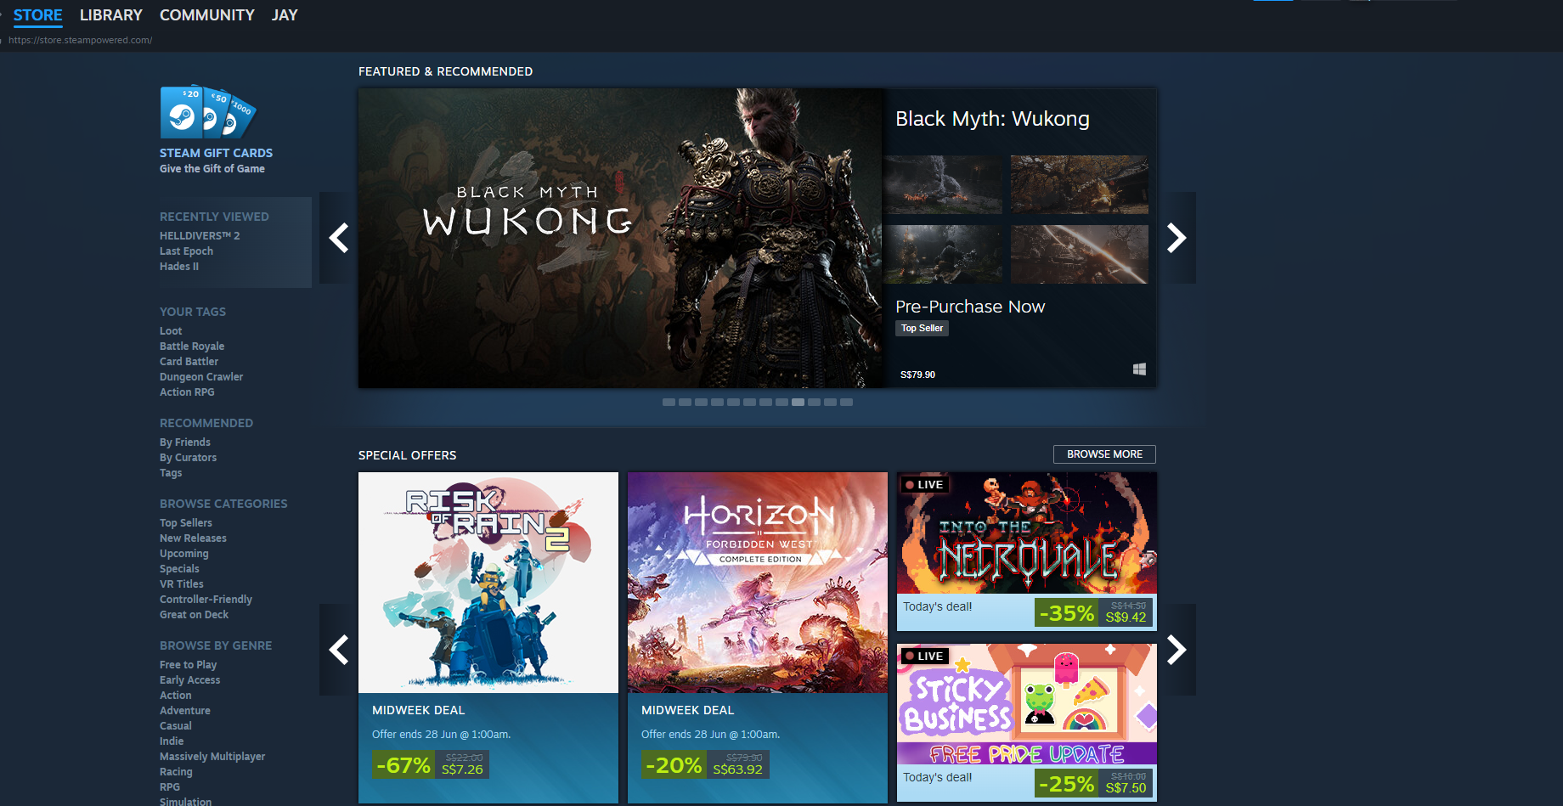
In-App Stores

Slide 22
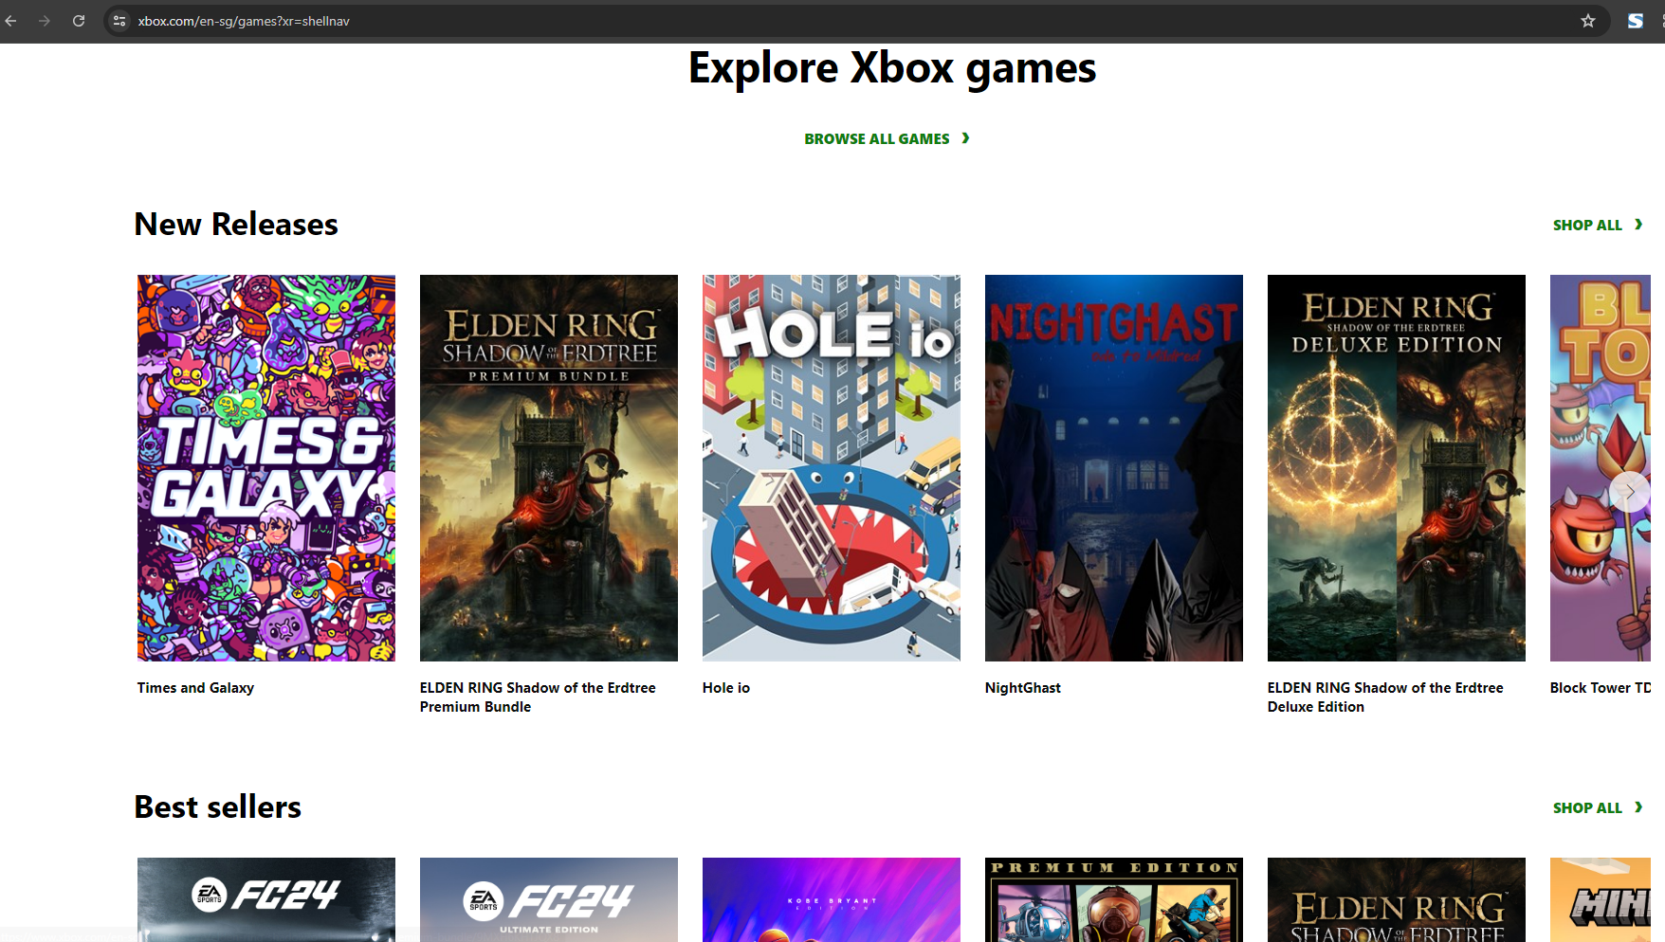
In-App Stores

Slide 23

In-App Stores

Slide 24
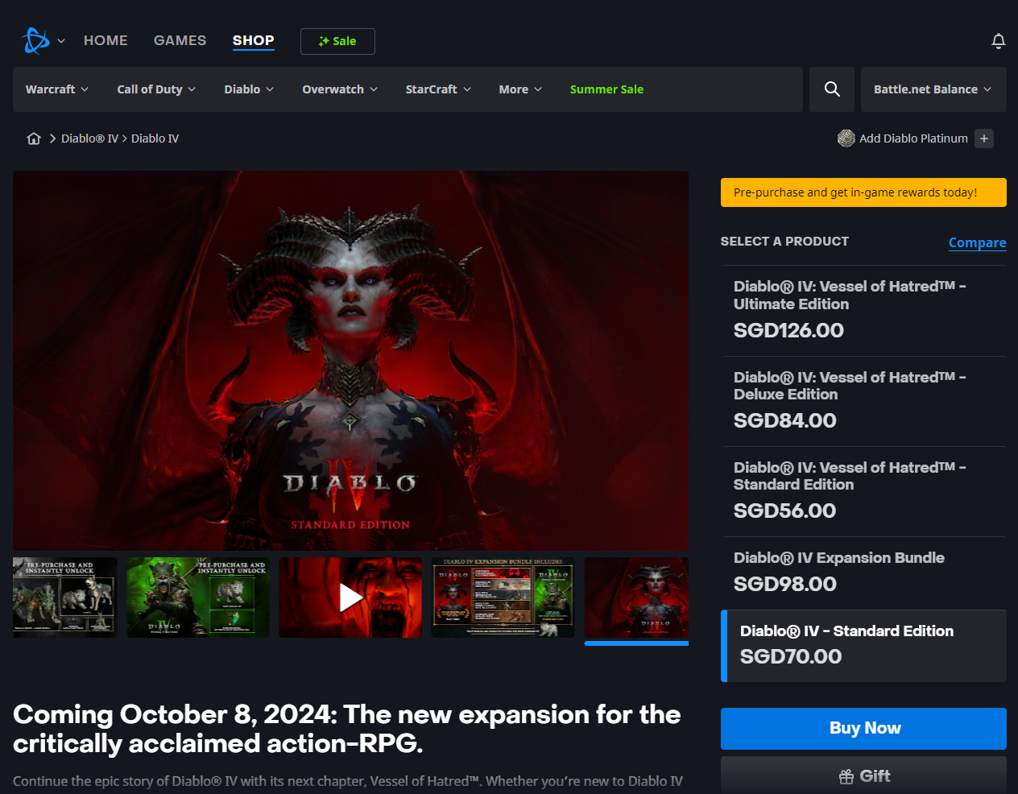
In-App Stores

Slide 25

In-App Reviews
Notes:
This is an example of critic score/reviews that are not included in our metadata.

Slide 26
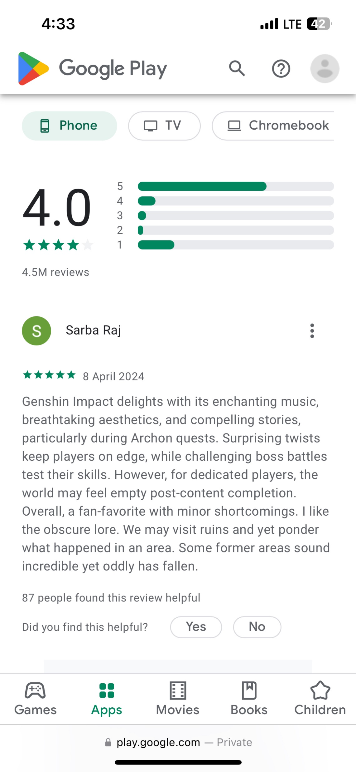
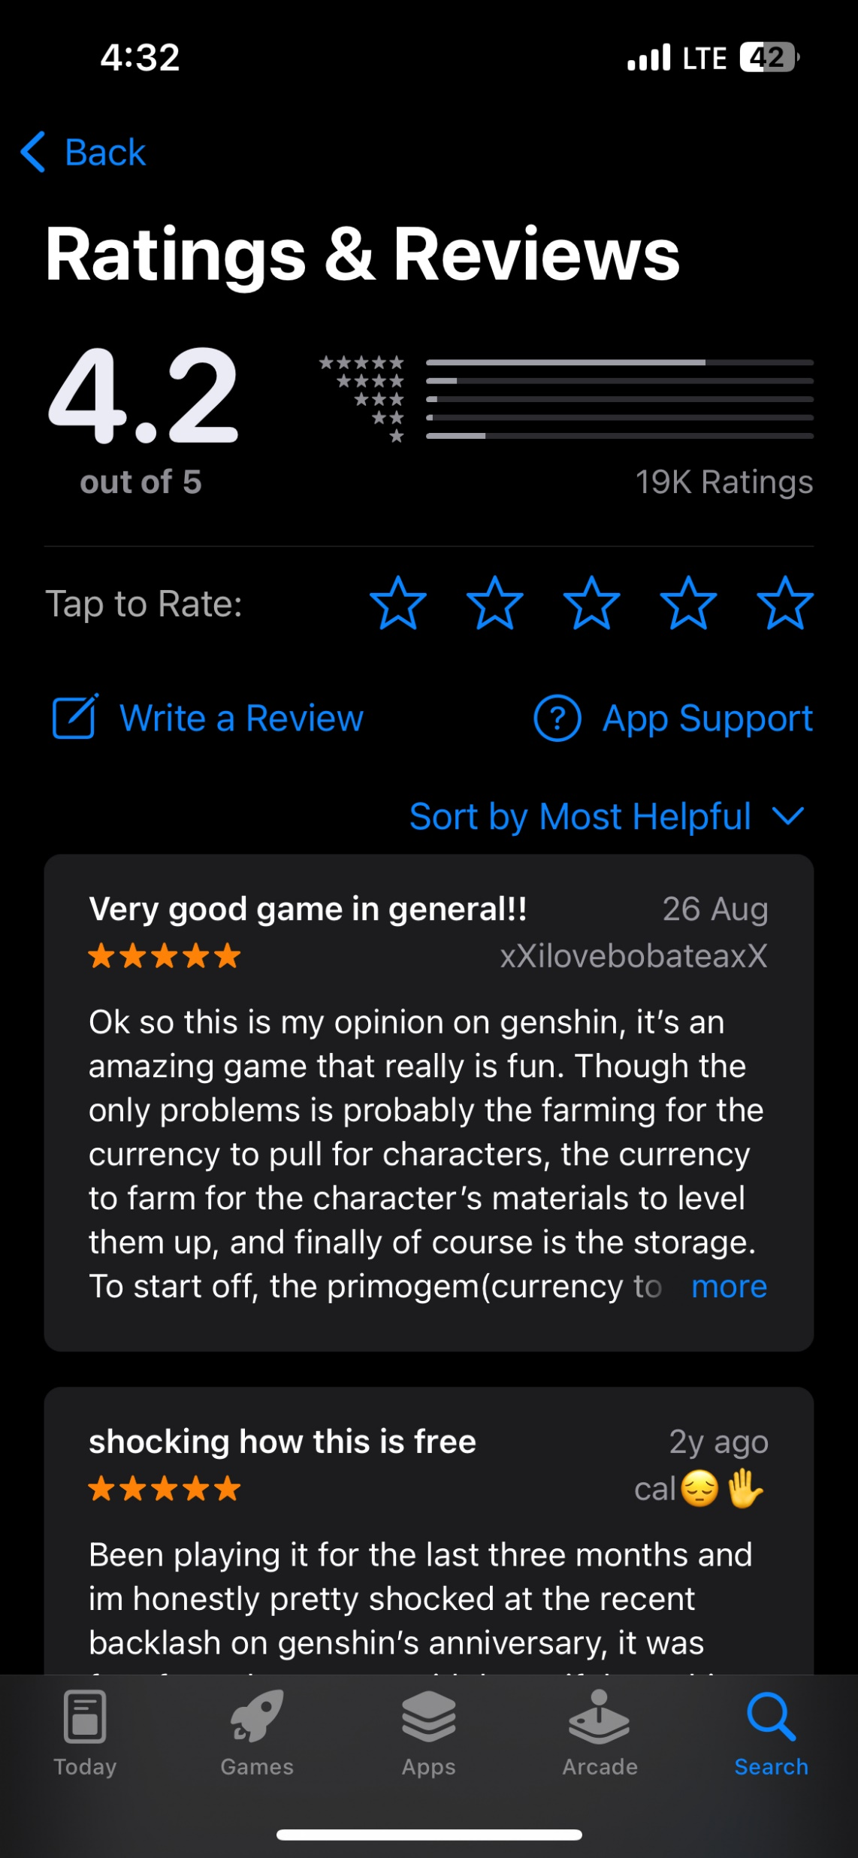
Apple Store Review
Google Play Store Review
Notes:
The Same goes for this slide, reviews from mobile app stores.

Slide 27
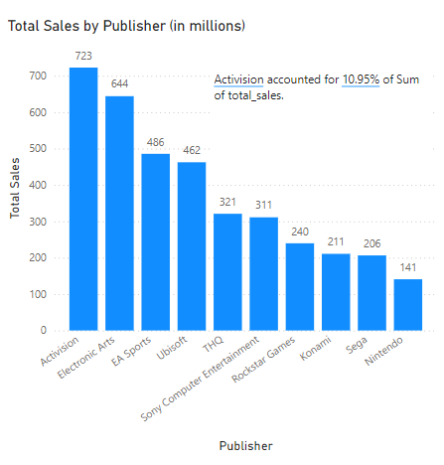
Notes:
This bar chart shows us that our focus should be on what genres Activision and EA they invest in. They seem to understand the workings of the video game industry better than their peers, to be able to maintain such a strong lead above others.

Slide 28
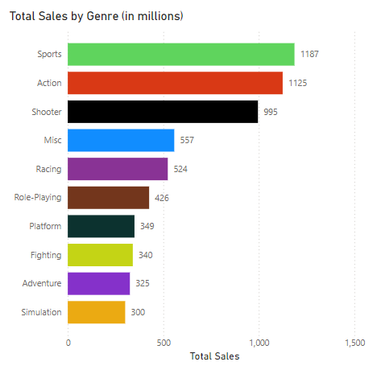
Notes:
Why is the sports genre in gaming so popular? Online multiplayer modes have revolutionized how players engage with sports video games. Players from around the world can now connect, compete, and collaborate, creating vast online communities that share a love for sports. Players can also engage in coaching their favourite teams, building their dream teams, and even experience living through great players in a way. Furthermore, it also allows people with physical constraints who are unable to participate in the sport in real life to be able to play it through the game from this slide, we will be taking a pivot into powerbi to further look at the sales breakdown by genre and publisher

Slide 29
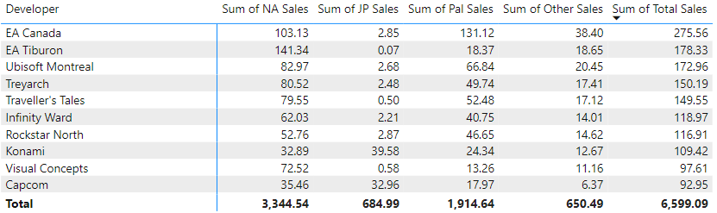
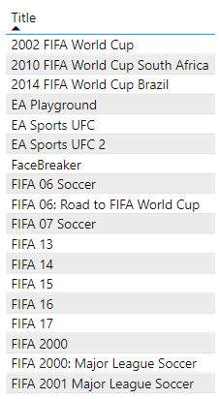
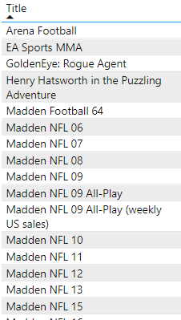
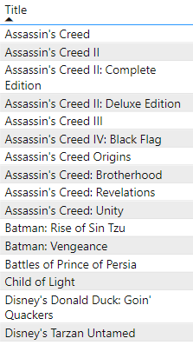

Developer Breakdown
EA Canada
EA Tiburon
Ubisoft Montral
Notes:
Objective #x Identification of top selling titles worldwide which was further broken down by developers to understand what strategies has worked for them to achieve market penetration across all regions.

Slide 30
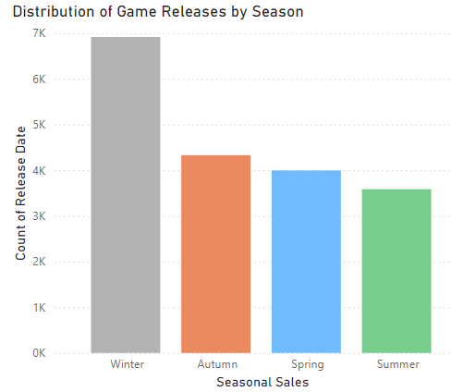

Seasonal Data
Notes:
This simple seasonal data breakdown, tells us that releasing a game during the winter/fall period would yield higher sales compared to a spring/summer release

Slide 31
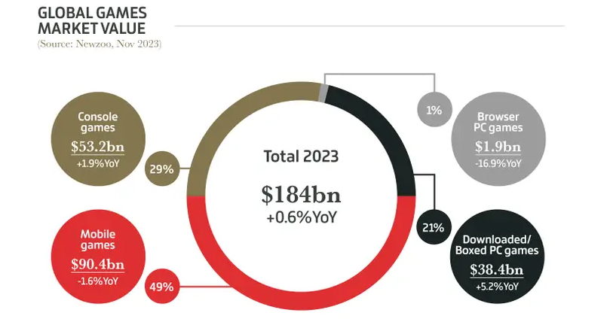
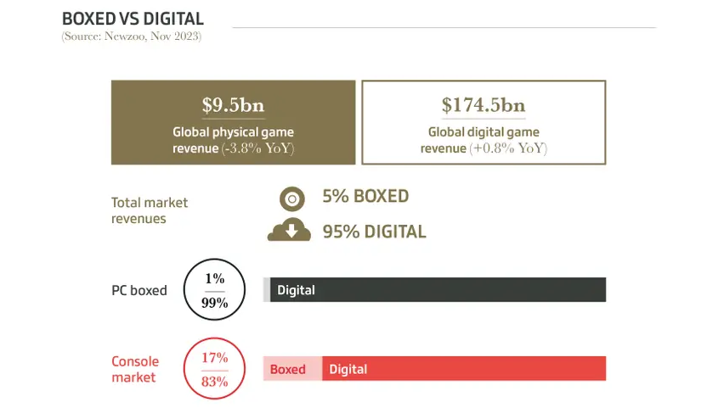
Digital to make 95% of video game revenues in 2023, or $174.5 Billion
Notes:
We step into the present era where we can see that PC market and console market sales are dominated by digital sales, with 1% of PC gamers and 17% of console gamers going for physical game purchases.
https://www.tweaktown.com/news/95135/digital-to-make-95-of-video-game-revenues-in-2023-or-174-5-billion/index.html#:~:text=Physical%20%2D%20%249.04%20billion%20(17%25,83%25%20of%20console%20gaming%20revenue)
https://www.gamesindustry.biz/gamesindustrybiz-presents-the-year-in-number-2023

Slide 32
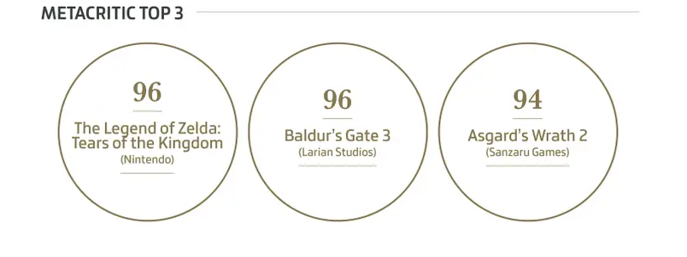
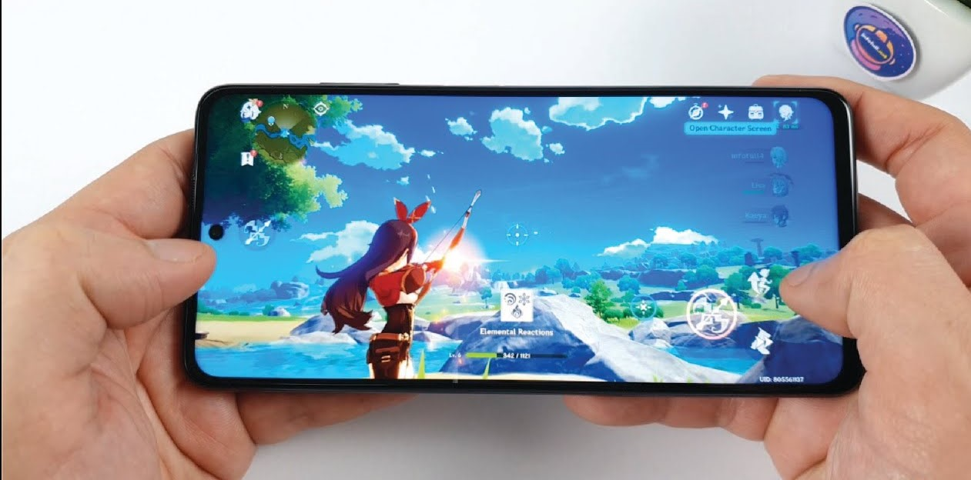
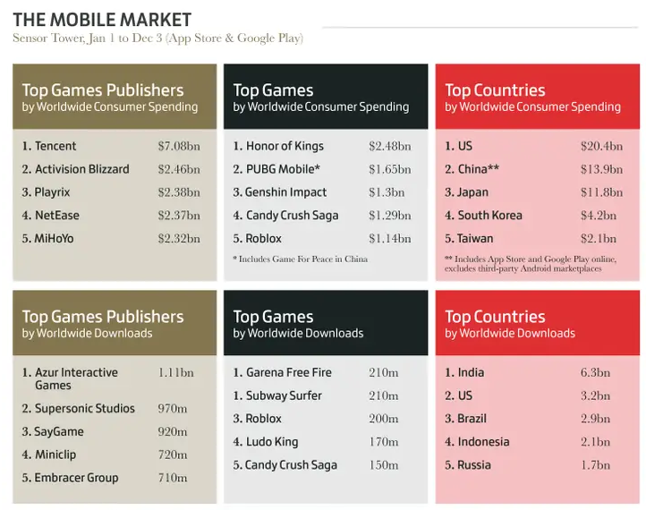
Mobile Platform (Console)
Notes:
We can see that in the mobile game industry mainly from mobile phones and consoles companies such as Tencent from china and Activision lead the market in product sales the most important field would be the top country in worldwide consumer spending, with US leading by a significant margin followed by china and Japan.

Slide 33
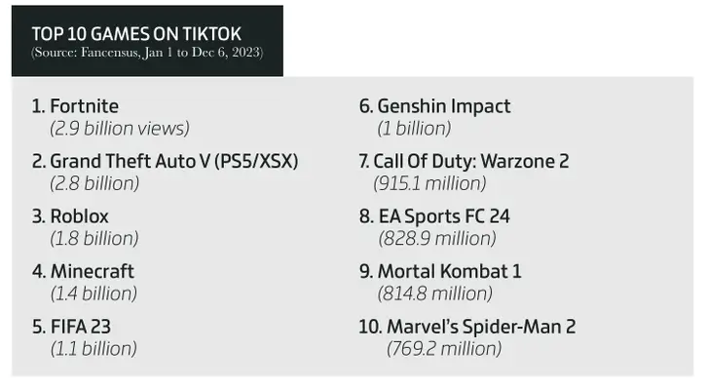
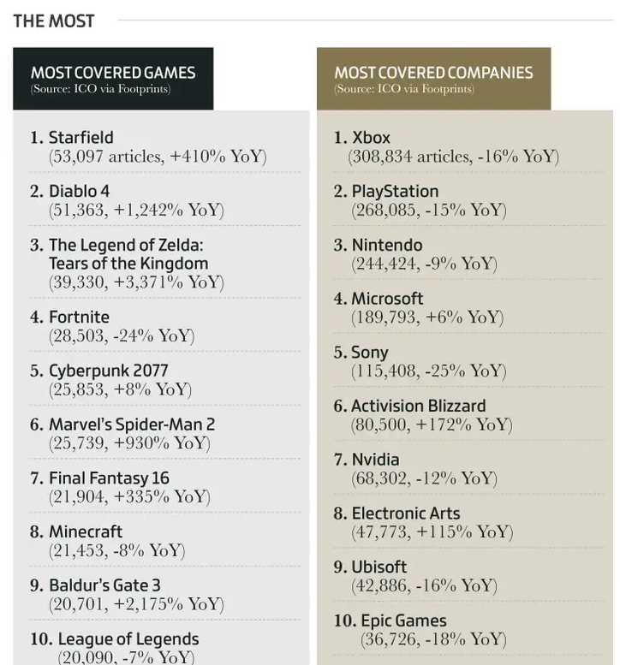
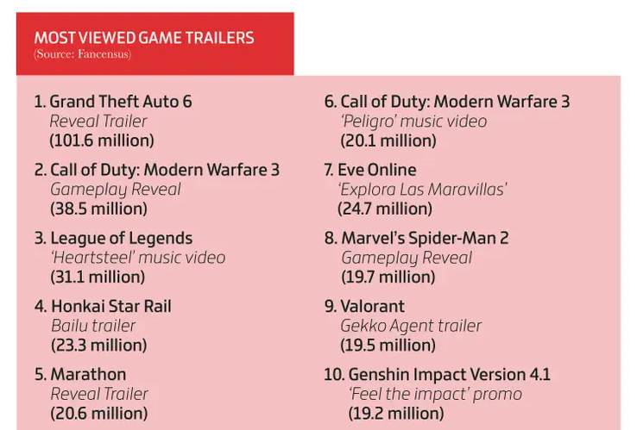
Notes:
This would be the beginning of the end of this presentation. Where we look into the future of the gaming industry, on the left this data shows the coverage of games and companies who develop and produced these games. We notice that the 6th place and 8th place has over a 100% increase in year on year coverage, which was the top 2 performing publishers in our data set. This shows that their investments in the sports and shooting genre has yielded tremendous results.
Adding on to that, we can see current trends on tiktok, as well as future trends in the industry from most viewed game trailer views.

Slide 34

Digital Sales | Physical Merchandise | Cross Platform Games
Notes:
We would therefore recommend a game that has cross platform support, that has both digital sales as well as physical sales, with the potential of adding merchandise to increase revenue. Much like this elden ring expansion released in June of 2024. our final 2 slides would be the 2 minimum viable products to suggest to you and the game developers behind you.

Slide 35


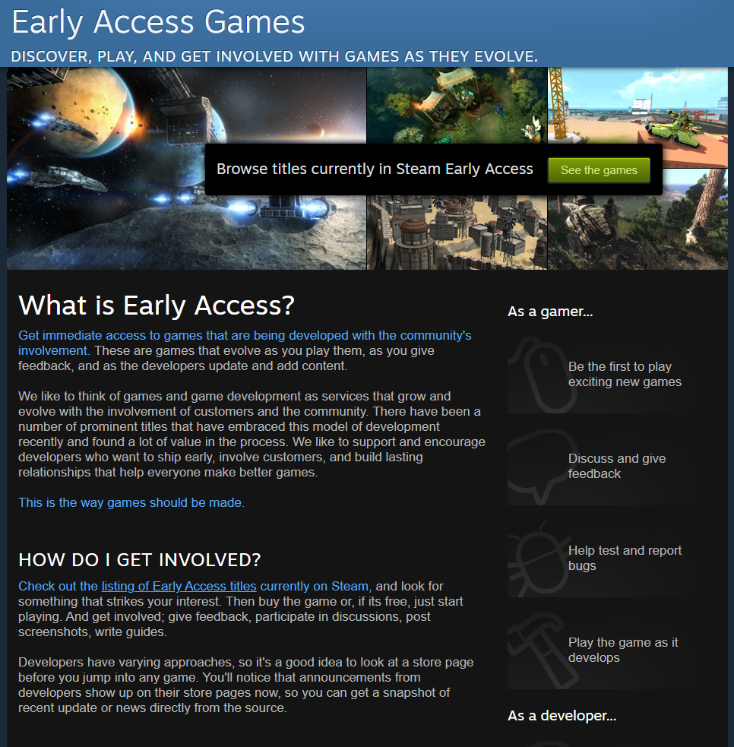

Minimum Viable Product 1
Notes:
This is the minimum viable product we would like to recommend,
Cross platform :
Football Game
Title: FIFA Year 3000
it is a cross platform compatible with all devices starting from the iphone 15 pro max, XBOX, Playstation, PC, and other consoles such as Nintendo Switch, Steam Deck, and more.
The video game would be based on a football game like FIFA 2024, but in an entirely new concept which is unexplored, a futuristic concept.
Our target audience would be gamers above the age of 12, who love sports and are looking for something fresh in the sports gaming genre.
We have recognized the complaints about FIFA 2023 and 2024 that there are not much differences except for the improvement of animation system.
We will be introducing new variants of game mechanics which would change the dynamics of traditional football such as the ability to reverse gravity, and many others.
This would require us to invest in developing new level designs which require more than a single level or environment
We will then invite a small group of prominent sports games influencers to do an offline alpha test to gather feedback on gameplay, performance and bugs before dropping a soft early access release on the steam platform.

Slide 36

Minimum Viable Product
Notes:
This is the minimum viable product we would like to recommend,
A cross platform shooter battle royale game called After The End it is set in a post apocalyptic world in 2045 after nuclear war has devastated the human race, and humans developed special abilities which changes the dynamics of the battlefield. To prevent the further use of nuclear weapons, countries send delegations to compete in a battle royale arena.
it will be a cross platform game compatible with all devices starting from the latest mobile devices, XBOX, Playstation, and pc

Slide 37
Citations
Strickland, D. (2024, January 9). Digital to make 95% of video game revenues in 2023, or $174.5 billion. TweakTown. https://www.tweaktown.com/news/95135/digital-to-make-95-of-video-game-revenues-in-2023-or-174-5-billion/index.html#:~:text=Physical%20%2D%20%249.04%20billion%20(17%25,83%25%20of%20console%20gaming%20revenue)
Batchelor, J. (2023, December 20). GamesIndustry.biz presents. . . The Year In Numbers 2023. GamesIndustry.biz. https://www.gamesindustry.biz/gamesindustrybiz-presents-the-year-in-number-2023
Physically Sold Video Games - Global | Market Forecast. (n.d.). Statista. https://www.statista.com/outlook/amo/media/games/physically-sold-video-games/worldwide

Slide 38
Thank you

